Slide 1
ELETRONIC STORE

Slide 2
CONTENT
Introduction
Objective
Modules
Use case diagram
ER Diagram
Android screenshots

Slide 3
INTRODUCTION
The "Electronic Store" has been developed to override the problems prevailing in the practicing manual system.
This software in supported to eliminate and in some cases reduce the hardships faced by this existing system.
Moreover this system is designed for the particular need of the company to carry out operations in a smooth and effective manner.

Slide 4
Every organization, whether big or small, has challenges to overcome and managing the information of Product Type, Product, Customer, Order, Payment.
Every Online Electronic Store has different Product needs , therefore we design exclusive customer management systems that are adapted to your managerial requirements.

Slide 5
Objective of Project on Online Electronic Store:
The main objective of the Project on Online Electronic manage the details of Product Products Type, Product Company, Customer Payment.
It manages all information about Product Order Payment Product.
The purpose of the projects to build an application program to reduce the manual work for managing the Product Type, Order Product Company.
It tracked about the Product Company Customer Payment.

Slide 6
MODULES
There are Six Main modules in my Online electronic shopping :-
Admin
Product
Specification
User Login
Cart
Payment

Slide 7
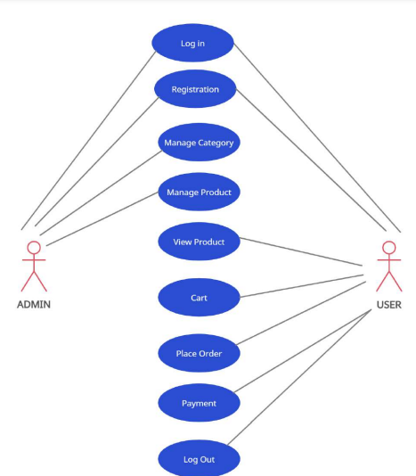

Slide 8
1. User Login:-
The User starts this action by inputting the username and password and clicking on the submit button.
2. Registration and creation of user profile:-
The system shall require a user to register, in order to carry out any transactions with it except for checking the availability of product.
It will ask the user for the following information at the least – a user id, a password, first name, last name, address, phone number, email address preferred.
The system will automatically create a ‘sky miles’ field and initialize it to zero in the user’s profile.

Slide 9
3. Customer shops for a product:
The customer initiates this action by clicking on the desired category for item to be displayed.
The page sends a message to the server requesting a listing of all products from the particular category from the database.
The action is complete when a page is returned for the customer to view, which contains available products with product names along with their picture, price, capacity, and an option to add the product to the shopping cart.
There is an option to link to next page, if more products are available than can fit on the page.

Slide 10
4. Customer searches for item:
The customer starts this action by typing a query into a text bore named description to search for description of an item.
The page sends a message to the server asking for a listing of products, whose names match the query, from the database.
The action is complete when a page is returned for the customer to view, which contains a list of the resulting products along with their picture, price, and an option to add the product to the shopping cart.
If a given description doesn't match with any descriptions in the database, a message indicating such is displayed instead of the option to add to cart.

Slide 11
5. Customer adds an item to cart:
The customer initiates this action by clicking on the buy button on the right side of to a product's listing.
An item is added to the cart including the price and displayed with the total price.
If the product already exists in the customer's cart, its quantity is increased by 1.
There is a Continue Shopping button for the customer to continuing shopping for other products.
6. Customer views cart:
The customer initiates this action by clicking on the view cart button, available on any webpage.
The page sends message to the server and shows a list of all products in the customer's cart, along with their quantity and total price.

Slide 12
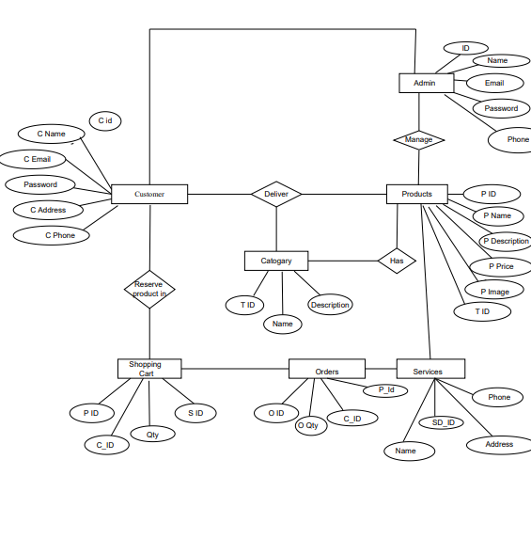

Slide 13
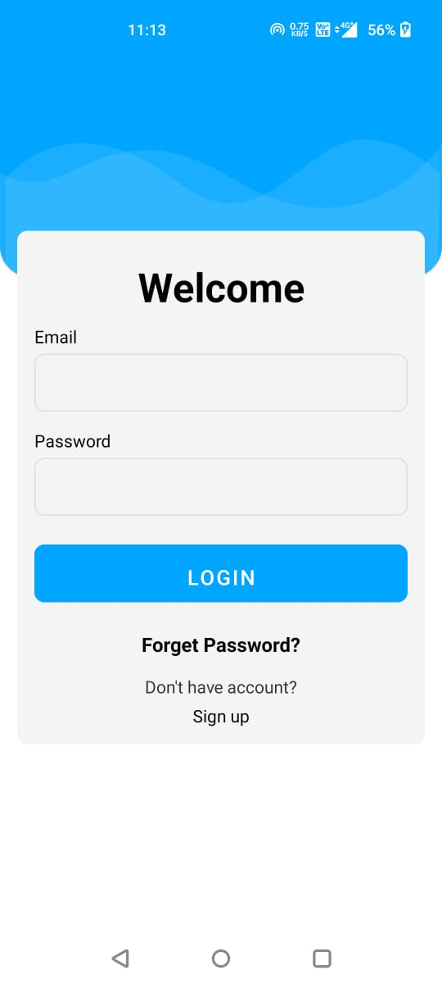

Slide 14
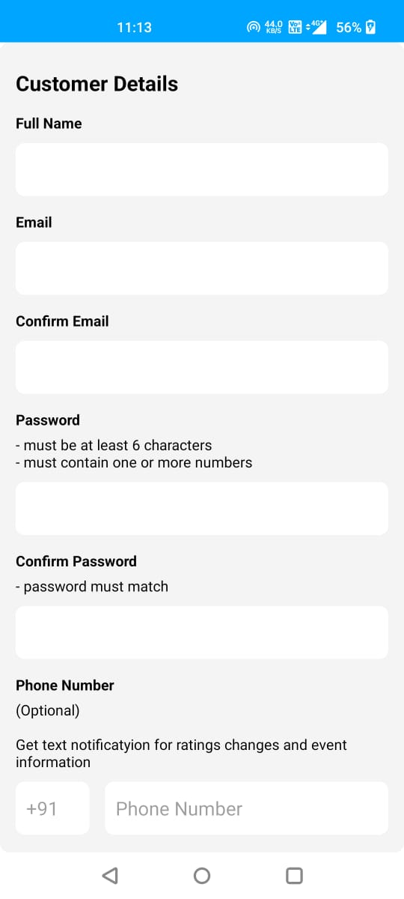

Slide 15
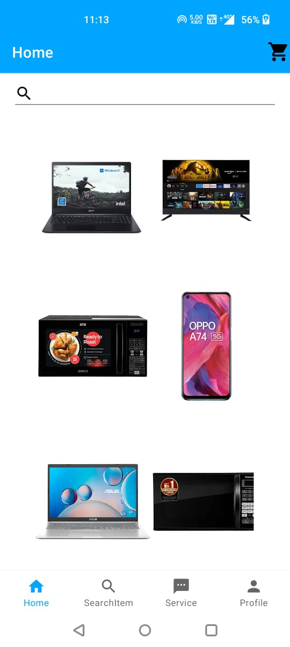

Slide 16
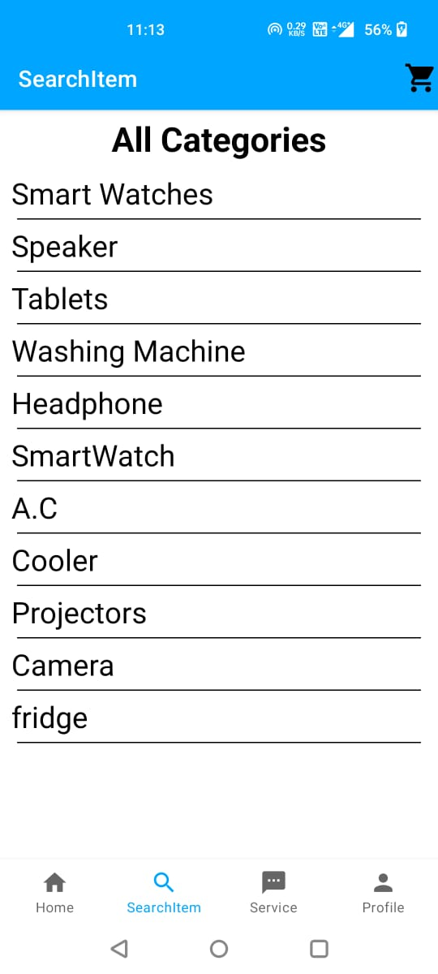

Slide 17
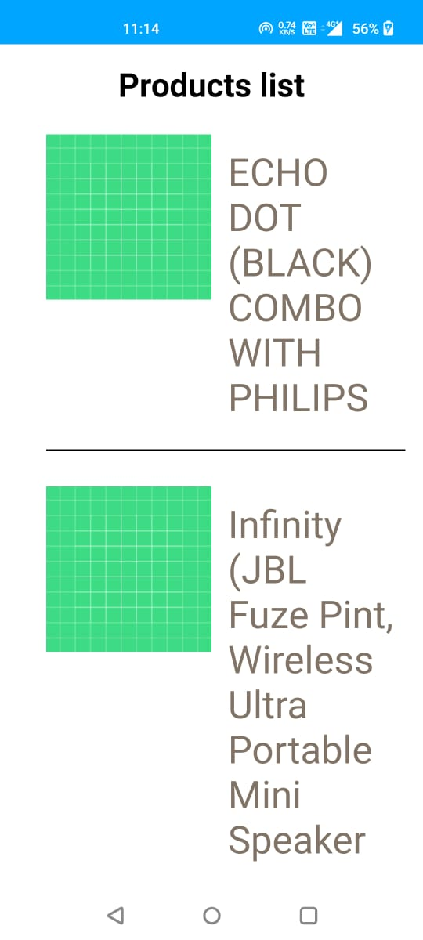

Slide 18
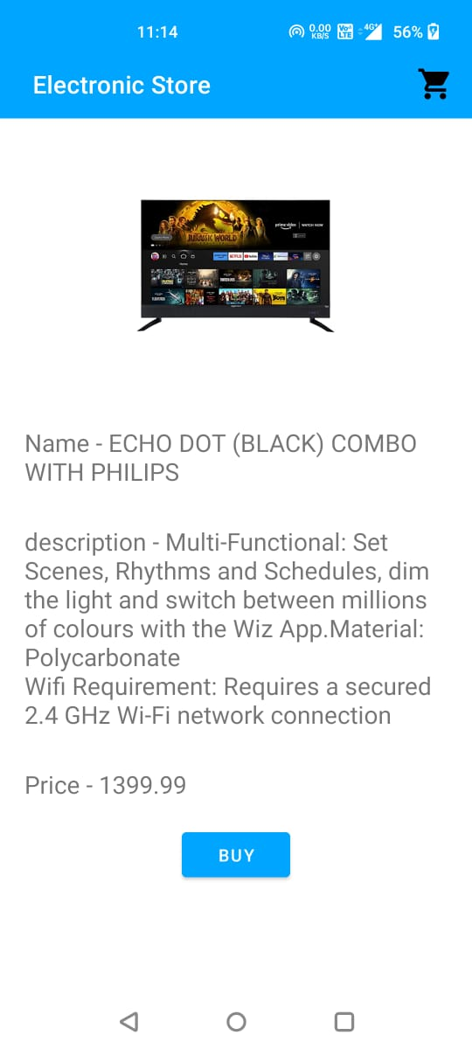

Slide 19
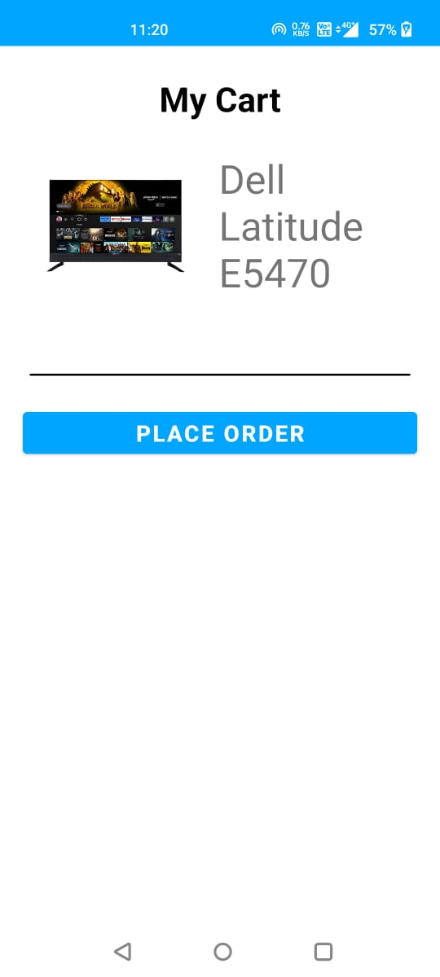

Slide 20
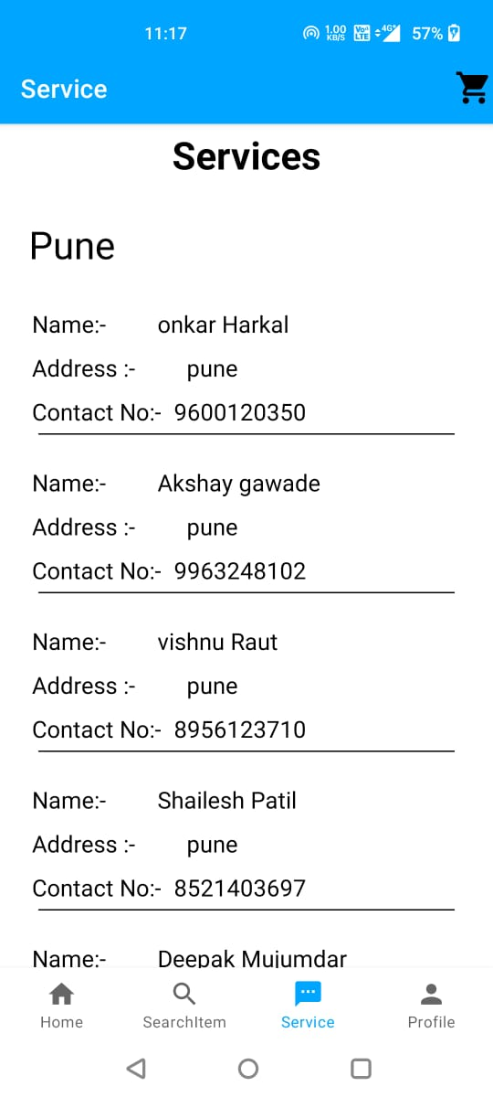

Slide 21
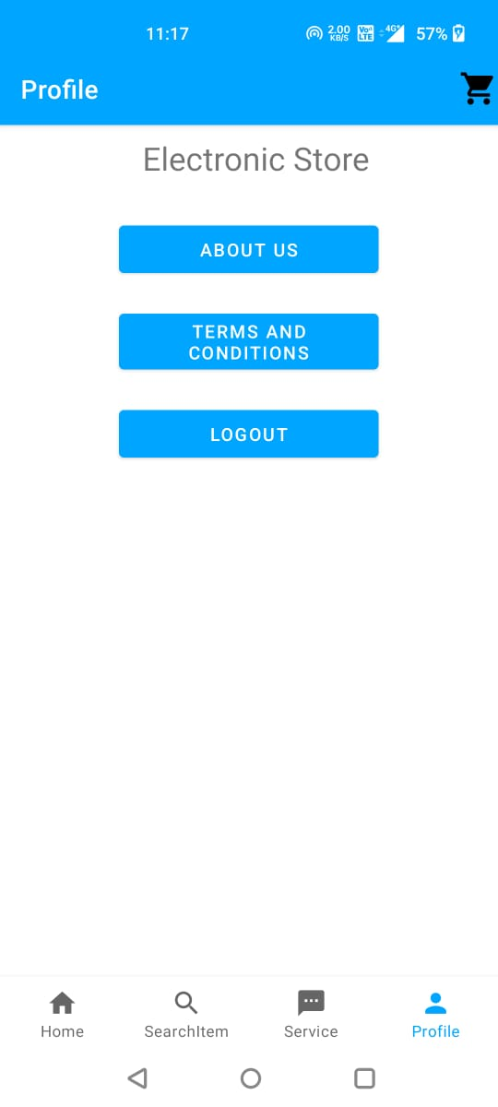

Slide 22
THANK YOU

